Slide 1
[
]
WEBCENTER PRO PROGRAM
A SYSTEM FOR YOUR SUCCESS

Slide 2
BUSINESS OPPORTUNITY
HOW MANY SMALL BUSINESSES ARE IN THE USA?
27 MILLION
HOW MANY HAVE WEBSITES?
46%
HOW MANY ARE MOBILE?
44%
Notes:
TRAINER’S NOTES:
Briefly cover the market opportunity
Do not go into depth, just cover the information on the slide

Slide 3
THE MARKETPLACE
54% don’t have a website at all
And almost half of those who do,
don’t have a responsive website
100%
need simplicity, efficiency & value
Notes:
TRAINER’S NOTES:
Self explanatory

Slide 4
SIMPLICITY. SYNERGY. ACCESSIBILITY
Website I Maintenance I Social Media I Digital Marketing I Options
Industry Professionals need this too!
Notes:
TRAINER’S NOTES:
Transition slide
Industry professionals need a solution to outsource work without outsourcing revenue. They need teams of professionals to lean on. They need options to scale their business, as well as options to create additional revenue streams and leverage in their businesses.

Slide 5
A COMPREHENSIVE DIGITAL STRATEGY
ONLINE SOLUTIONS
MERCHANT SERVICES
CUSTOMERS
WEBSITES
ECOMMERCE
GOOGLE
SOCIAL MEDIA
CONTENT
COMMUNICATION
CREDIT CARD FEES
REDUCE FEES
CARD SWIPER
SHOP.COM PARTNER
SHOP LOCAL
PREFERRED CUSTOMER PROGRAM
Notes:
TRAINER’S NOTES:
We offer Online Solutions, such as…..
We offer Merchant Services, such as…
And we offer clients the ability to become Shop.com Partners, ShopLocal customers, or Preferred Customers to save money on business expenses.

Slide 6
What Makes Us Different
Our clients are getting more than just a website, they are getting an entire online marketing strategy.
Let’s take a look at the myriad of tools and options that our clients have.
Notes:
TRAINER’S NOTES:
Introduce the concept of online marketing strategy verses just a website

Slide 7
MORE THAN JUST A WEBSITE
Unlimited Pages
Unlimited Changes
Unlimited Traffic
Unlimited E-mail Address
Unlimited Web Content Storage
Unlimited support, changes and upgrades.
We take away the challenges that business owners face to stay current with their online marketing solution.
The Power of Unlimited
Notes:
Trainers Notes:
This is just an intro slide – The goal here is to get them excited about what we are going to talk about.
In brief, cover the big topics “Websites, Marketing Tools, Unlimited, Support, Security)
The goal is to paint a simple picture of how all –inclusive our solution actually is / Instill confidence in the product.
Spend 1 minute or less on this slide – the details are coming up!

Slide 8
eCommerce Tools
Configurable product options that adjust the sales price
Shopper wish list
Pan and zoom product image
Compare products
Order history with easy “Reorder” feature
Multiple billing options
Shopper product reviews
Product tags
Sales dashboard
See who’s shopping
Enhanced Product Catalog search results with product thumbnails
Notes:
TRAINER’S NOTES:
Our e-commerce system is incredibly flexible.
There is so much which can be done with it.
(share some personal examples from your own client base).
(hit some of the highlights from the Features & Benefits).
Again, this is about providing an effective Internet presence. If the business owner’s current solution doesn’t allow for customer reviews or wish lists, is it an effective internet presence? Nope!
No transaction fees!

Slide 9
AWARD-WINNING,
UNLIMITED CUSTOMER CARE
Unlimited help editing the site
Support using all features & tools in our solution
Home country, 24/7 support
Ultra-secure hosting facility 24x7 Security and incident monitoring, hosted on tiered, high performance Dell PowerEdge servers, protected from fire, floods, earthquakes, power outages, and other types of disasters
Dual-layer firewall protection Using Cisco PIX firewalls
Notes:
Trainers Notes:
Share Stories!

Slide 10
WEB MANAGEMENT
BASIC MONTHLY MEMBERSHIP
Includes hosting, CMS, live chat. (no ecommerce, CRM, email marketing or voice support)
MONTHLY MEMBERSHIP
Includes hosting, emails, unlimited technical support editing their website and using the marketing tools and unlimited upgrades to the platform.
MANAGED MONTHLY MEMBERSHIP
Includes everything that comes in monthly membership plus up to 10 hours/month of editing and content management. Free premium responsive layout every year.
LISTEN:
Do you or clients want to save time or money?
Do your clients have the resources to manage their own site?
Notes:
TRAINER’S NOTES:
MOST IMPORTANT: “LISTEN FOR” So you can offer a solution to the problem
You can use the B2B Catalog (pictured on the right) to educate a client on how we compare and what we offer with our core solution
Product Specialists can answer further questions on this during an appointment
There are FAQs on mawc411.com and mawebcenters.com

Slide 11
DESIGN OPTIONS
DESIGN CENTER
Clients have a variety of options for getting their website designed. The layout of the website along with your site’s content are critical to help you establish an effective Internet presence.
All of our design packages are designed inside the editable maWebCenters platform so you have the flexibility to maintain your content or add more pages in the future.
WebCenter Professionals can store previously designed layouts for future use.
LISTEN:
Do you want to design sites yourself?
Would you prefer we design?
Notes:
TRAINER’S NOTES:
MOST IMPORTANT: “LISTEN FOR” So you can offer a solution to the problem
You can use the B2B Catalog (pictured on the right) to educate a client on how we compare and what we offer with our core solution
Product Specialists can answer further questions on this during an appointment
There are FAQs on mawc411.com and mawebcenters.com

Slide 12
DESIGN CENTER

Slide 13
DESIGN CENTER

Slide 14
DESIGN CENTER

Slide 15
DESIGN CENTER

Slide 16
DIGITAL MARKETING:
Marketing your business through digital channels.
OPTION 1: TECH SUPPORT Website Clients have unlimited access to Tech Support
OPTION 2: SERVICES
Purchase Digital Marketing Products.(Can be purchased by existing clients or non-website clients)

Slide 17
COMMUNICATION
EMAIL MARKETING
As part of the website platform, there is a customer database tool that also allows website clients to create email newsletters, campaigns, as well as access to email statistics.
TEXT MESSAGE MARKETING
Morse Connect is a robust text marketing product that enables a landline or Toll-Free number to receive text messages. The service also allows for text promotional campaigns, individual responses, as well as autoresponders based on keyword and keyword phrases to streamline business communication and increase customer/client engagement
CHALLENGE:
How are you communicating with clients?
Could they use increased engagement?
Do they need to improve client communication
Are they leveraging text message marketing?
Notes:
TRAINER’S NOTES:
MOST IMPORTANT: “LISTEN FOR” So you can offer a solution to the problem
You can use the B2B Catalog (pictured on the right) to educate a client on how we compare and what we offer with our core solution
Product Specialists can answer further questions on this during an appointment
There are FAQs on mawc411.com and mawebcenters.com

Slide 18
SEO
LOCAL AND REGIONAL SEO
Search Engine Optimization, ensures your business ranks high on search engines like Google and Yahoo when a consumer is looking for a specific product or service.
We’ll discuss your desired goals related to your website, the geographic areas you wish to reach, and the demographics of your desired customer. We conduct SEO tasks related to site keywords, page titles, headings, page descriptions, and many more ways to make you stand out from the crowd.
CHALLENGE:
Is their site showing up in Search?
Are they ranking against their competition?
Are there new products and services they want to be found for?
Notes:
TRAINER’S NOTES:
MOST IMPORTANT: “LISTEN FOR” So you can offer a solution to the problem
You can use the B2B Catalog (pictured on the right) to educate a client on how we compare and what we offer with our core solution
Product Specialists can answer further questions on this during an appointment
There are FAQs on mawc411.com and mawebcenters.com

Slide 19
GOOGLE ADWORDS
GOOGLE ADWORDS
Search engine giant Google offers its paid AdWords service to businesses who wish to enhance their Internet marketing efforts.
Our SEO specialists will guide you through the AdWords process, taking care of subjects like account creation, campaigns, budgets, networks, mobile device targeting, geographical targeting and much much more.
CHALLENGE:
Who manages their Adwords?
Do they need quick results?
Do they have a great site but just need help marketing it?
Notes:
TRAINER’S NOTES:
MOST IMPORTANT: “LISTEN FOR” So you can offer a solution to the problem
You can use the B2B Catalog (pictured on the right) to educate a client on how we compare and what we offer with our core solution
Product Specialists can answer further questions on this during an appointment
There are FAQs on mawc411.com and mawebcenters.com

Slide 20
SOCIAL MEDIA
SOCIAL MEDIA MANAGEMENT
We offer a smooth, results-driven package in which our specialists will create profiles on the social media sites of your choice, post written and image-driven content each week, and respond to comments or questions that might arise on these highly viewed services.
ONLINE REPUTATION MANAGEMENT
Our online reputation management services include a monthly scan of the online world for negative reviews, and clear reporting of activity on consumer review sites that could affect your revenue, profits and foot traffic.
CHALLENGE:
Are they leveraging Social Media?
Are the consistent with posting & responding?
Do they monitor online reviews?
Who manages their online listings?
Notes:
TRAINER’S NOTES:
MOST IMPORTANT: “LISTEN FOR” So you can offer a solution to the problem
You can use the B2B Catalog (pictured on the right) to educate a client on how we compare and what we offer with our core solution
Product Specialists can answer further questions on this during an appointment
There are FAQs on mawc411.com and mawebcenters.com

Slide 21
FACEBOOK ADS
FACEBOOK ADVERTISING
Billions of people are on Facebook, so you can be sure that we’ll find you an audience.
We’ll discuss with you your target market demographics, the geographic area you wish to reach, and all other vital details to get your campaign kicked off.
Expect a monthly consultation and report detailing exactly where your hard earned marketing dollars are going.
CHALLENGE:
Are your clients on Facebook?
Could they use increased exposure?
Do they need to grow engagement on their business Facebook page?
Are they leveraging Facebook Ads?
Notes:
TRAINER’S NOTES:
MOST IMPORTANT: “LISTEN FOR” So you can offer a solution to the problem
You can use the B2B Catalog (pictured on the right) to educate a client on how we compare and what we offer with our core solution
Product Specialists can answer further questions on this during an appointment
There are FAQs on mawc411.com and mawebcenters.com

Slide 22
REFERRAL MARKETING
SHOP LOCAL
Drive more foot traffic to your physical business.
SHOP.COM PARTNER STORE
Drive traffic to your website via our over 3 million loyal customers and 200,000 UFO websites.
APN (AFFILIATE PUBLISHER NETWORK)
Publish relevant SHOP Products right to your site and earn commission for referring the sale.
CHALLENGE:
Are they looking for more “in store traffic”?
Are they looking for more online traffic?
Are they looking for an additional stream of income?
Notes:
TRAINER’S NOTES:
MOST IMPORTANT: “LISTEN FOR” So you can offer a solution to the problem
You can use the B2B Catalog (pictured on the right) to educate a client on how we compare and what we offer with our core solution
Product Specialists can answer further questions on this during an appointment
There are FAQs on mawc411.com and mawebcenters.com

Slide 23
WEBCENTER PRO PROGRAM: WEBCENTER-PRO.COM
LINE OF PRODUCTS
TEAMS OF PROFESSIONALS
CO-BRANDED ADMIN & INVOICING
FULLY CUSTOMIZABLE FRONT END SITE
VIP SUPPORT
PROFESSIONAL EDUCATION

Slide 24
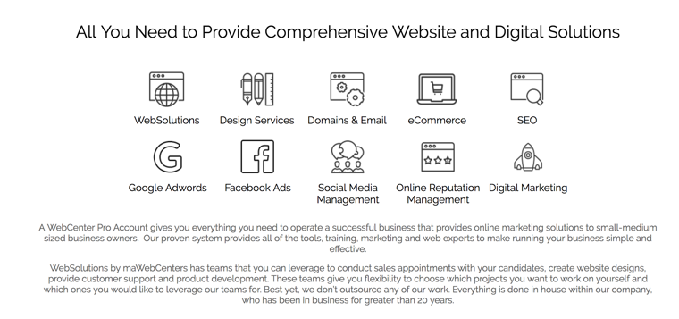
DIGITAL PRODUCTS:
EXPAND YOUR OFFERING
Notes:
TRAINER’S NOTES:
Maybe you’re a website designer or developer, but your clients need search engine or social media exposure
Perhaps you’re a social media agency but need a website solution
Or you’re focused on larger projects and turn smaller projects away, where you could retain these clients without negatively impacting profitability.

Slide 25
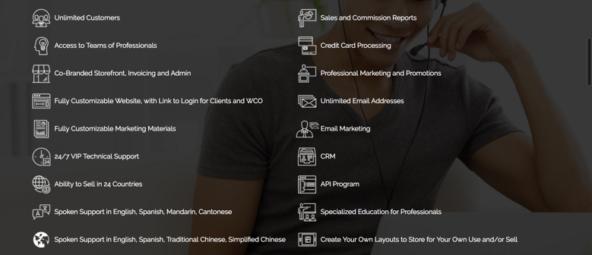
PRO PROGRAM BENEFITS

Slide 26
PRO EDUCATION
Leverage industry experts in:
Website Design
Website Development
Content Writing
SEO & SEM
Social Media
E-Commerce
Sales & Marketing Strategy
Account Management
Business Development

Slide 27
WEBCENTER PRO &THE UNFRANCHISE® BUSINESS
CLIENTS EARN CASHBACK
YOU EARN RETAIL PROFITS
YOU EARN ONGOING INCOME
CLIENTS EARN CASHBACK FROM THEIR ONLINE PURCHASES FOR BUSINESS EXPENSES OR PERSONAL PURCHASES ON YOUR SHOP.COM WEBSITE
EARN GROSS RETAIL PROFITS FROM WEBSITES AND DIGITAL MARKETING PRODUCTS THAT YOU SELL.
MANY DIGTIAL MARKETING PRODUCTS ALSO GENERATE MONTHLY RETAIL PROFITS
PRO AFFILIATES: Earn $300 -$1,500/week from BV generated as a result of your sales and your organization
PRO PARTNERS: Earn $300 - $3,600/ week per BDC from BV and IBV generated as a result of your sales and your organization with unlimited earning potential through multiple BDC’s
†EARN 30-50% GROSS RETAIL PROFIT ON MOST PRODUCTS, WHEN SOLD AT SUGGESTED RETAIL PRICE. EARN UP TO 1000% GROSS RETAIL PROFIT ON THE SALE OF WEBSITES.
*THE INCOME LEVELS MENTIONED IN THE FOLLOWING PRESENTATION ARE FOR ILLUSTRATION PURPOSES ONLY. THEY ARE NOT INTENDED TO REPRESENT THE INCOME OF A TYPICAL MARKET AMERICA UNFRANCHISE OWNER, NOR ARE THEY INTENDED TO REPRESENT THAT ANY GIVEN UNFRANCHISE OWNER WILL EARN INCOME IN THAT AMOUNT. THE SUCCESS OF ANY MARKET AMERICA UNFRANCHISE OWNER WILL DEPEND UPON THE AMOUNT OF HARD WORK, TALENT, AND DEDICATION WHICH HE OR SHE DEVOTES TO BUILDING HIS OR HER MARKET AMERICA BUSINESS.
Notes:
TRAINER’S NOTES:
Explain “BV”: we track Gross Sales Volume and offer a unique compensation beyond your own retail sales
This Gross Sales Volume is created from an entire network of collaborating professionals

Slide 28
GET PAID TO SHOP
NEVER MISS A DEAL
SHOP.COM PARTNER STORES CARRY CASHBACK AND IBV (POINTS)
YOUR CUSTOMERS EARN CASHBACK
YOU EARN IBV ON YOUR ONLINE PURCHASES AND THEIRS*
*WebCenter Pro Partners

Slide 29
Let’s take a look at earning potential
Retail Profit
BV
Growth Potential
Notes:
TRAINER’S NOTES:
Earning potential will be demonstrated in terms of short term and long term growth potential

Slide 30
Income disclaimer
Earnings depicted are atypical and the success of any UnFranchise® Owner will depend upon the amount of hard work, talent and dedication which he or she devotes to building his or her Market America business. For typical earnings, see market-america.info/mais.

Slide 31
RETAIL PROFIT PER SITE SOLD
USA: $100 - $2,700
ADDITIONAL RETAIL PROFITS:
Web Design
SEO
Google Advertising (Recurring)
Facebook Advertising (Recurring)
Social Media Management (Recurring)
Online Reputation Management (Recurring)
Morse Connect SMS Services (Recurring)
Short term goals can be met with retail profits
Notes:
TRAINER’S NOTES:
Again – you can apply this to any of your fixed cost goals

Slide 32
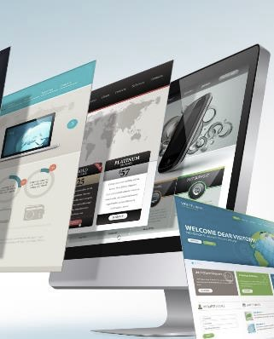
Each website sold
Generates UP TO 240 BV
Each active client
generates
10, 30 or 40 BV / Mo.
DIGITAL MARKETING PRODUCTS GENERATE ADDITIONAL BV AND RETAIL PROFITS
Notes:
TRAINER’S NOTES:
Long Term Potential for WCOS = Ongoing BV and Retail Profits
Describe Business Volume as a unit point value attached to each product and service based on profit margin which will accumulate to pay out additional commissions on Gross Business (Sales) Volume.

Slide 33
Build share of customer
ITEM | RETAIL PROFIT | BV
WEBSITE SALE | $1,000 | 200 BV 30/ MO.
LOCAL SEO | $26 | 75
SOCIAL MEDIA MANAGEMENT | $15/ MO. | 20 BV/ MO.
PREMIUM FACEBOOK ADVERTISING | $10/ MO. | 15 BV/ MO.
BASIC GOOGLE ADVERTISING | $24/ MO. | 24 BV/ MO.
TOTAL INITIAL SALE | $1,075 | 364 BV
TOTAL RECURRING | $49/ MO. | 89 BV/ MO.
Your client buys a website
AND wants to market the site
YOU CAN START WITH A WEBSITE SALE OR A DIGITAL MARKETING PRODUCT SALE
GROW THE RELATIONSHIP TO BUILD SHARE OF CUSTOMER
Notes:
TRAINER’S NOTES:
Take a look at what the Digital Marketing Products generate
Pricing Guide with Retail and BV is available in Support Materials on unfranchise.com

Slide 34
Australia
Bahamas
Bermuda
Canada
Chile
China
Colombia
Costa Rica
Dominican Republic
Ecuador
Hong Kong
Indonesia
Ireland
Jamaica
Macau SAR China
Malaysia
New Zealand
Panama
Philippines
Singapore
Spain
Taiwan*
United Kingdom
United States
YOUR GLOBAL WEBCENTER
Your WebCenter is automatically enabled to sell websites globally in all Market Countries & EMP Countries. You earn Home Country Retail Profit & BV!
Notes:
TRAINER’S NOTES:
What does that do for us?
First, by having websites which are completely in other languages and the entire back end of the system, including the menus and contextual help, the business owners who are more comfortable with another language will be able to take more effective use of the solution.
Second, by providing all the support, from sales to ongoing support with clients, all in multi-languages.
As a non-native speaker, you can probably find numerous business owners who you can have a short conversation to set an appointment with, but you wouldn’t be able to do a sales walkthrough because the business owner might not understand English well enough. This way, all you need to do is set the appointment, and let the team handle the rest for you!
And we all know that some of your best business prospects are business owners and customers of yours. This is a very natural way to lead to prospects for the business in a cultural market you might not have thought you could make inroads to.

Slide 35
PRO AFFILIATE
FULL ACCESS TO THE PRO PROGRAM &
LIGHT ACCESS TO THE UNFRANCHISE BUSINESS
Earn up to $1,500/ Week in BV commissions
BV commission is capped at $78,000/year
Cannot sponsor or expand a sales organization
Cannot receive BV placed from senior business partners
Cannot place BV beyond personal business centers
Does not count as “activation” for Senior Partners
Does count for Senior Partner bonuses
*Documentation as an industry professional is required upon application.
Notes:
TRAINER’S NOTES:
Pro Affiliates do not have minimum activity requirements, monthly accrual, and cannot sponsor or give/receive BV
Must have current monthly UFMS, includes HurdlR
Does receive and accrue Group Business Volume

Slide 36
PRO PARTNER
FULL ACCESS TO THE PRO PROGRAM &
FULL ACCESS TO THE UNFRANCHISE BUSINESS
Earn up to $2,100/ Week in BV commissions
Earn up to $1,500/ Week in IBV commissions
Unlimited Earning Potential for BV/IBV commissions
Can sponsor and expand a sales organization
Can receive BV placed from senior business partners
Can place BV in personally sponsored
Does count as “activation” for Senior Partners
Does count for Senior Partner bonuses
*Documentation as an industry professional is required upon application or verification of a WebCenter Owner with more than 20 website sales.
Notes:
TRAINER’S NOTES:
Pro Partners DO not have minimum activity requirements, monthly accrual, and can sponsor and give/receive BV per BV Placement Designation Rules
Commissions earned are based on MPCP including Activation
Must have current monthly UFMS, includes HurdlR
Does receive and accrue Group Business Volume

Slide 37
CREATE AN ONGOING INCOME with BV & IBV
COMMISSIONS
WEBCENTER PROS ARE PART OF A DISTRIBUTION ORGANIZATION THAT GENERATES GROUP BUSINESS VOLUME (BV & IBV)
*GRAY INDICATES PERSONALLY SPONSORED UNFRANCHISE® OWNER
Notes:
Describe the Network in terms of referral alliances of businesses they may already collaborate with. Graphic Designers, SEO firms, Ad agencies, Web Developers, Stay at home freelancers, Traditional business owners

Slide 38
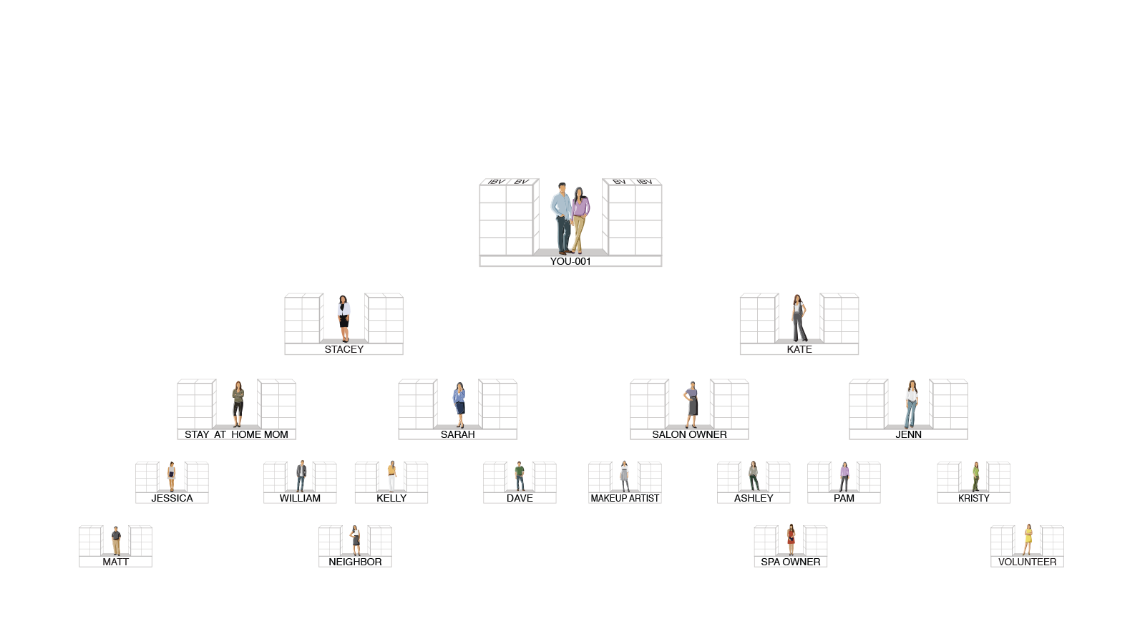
OUR TRACKING SYSTEM SEARCHES DAILY TO INFINITY
THE SYSTEM TRACKS PURCHASES AND SALES MADE BY YOU, YOUR CUSTOMERS AND YOUR TEAM. YOU RECEIVE 100% CREDIT FOR ALL VOLUME GENERATED WITHIN YOUR ORGANIZATION
Notes:
TRAINER’S NOTES:
Reference these contacts as other professionals they currently collaborate and network with as well as some of their business clients.
Reference health professionals, gyms, salons, etc. in order to tie-in people they may know that can participate in this network organization.

Slide 39
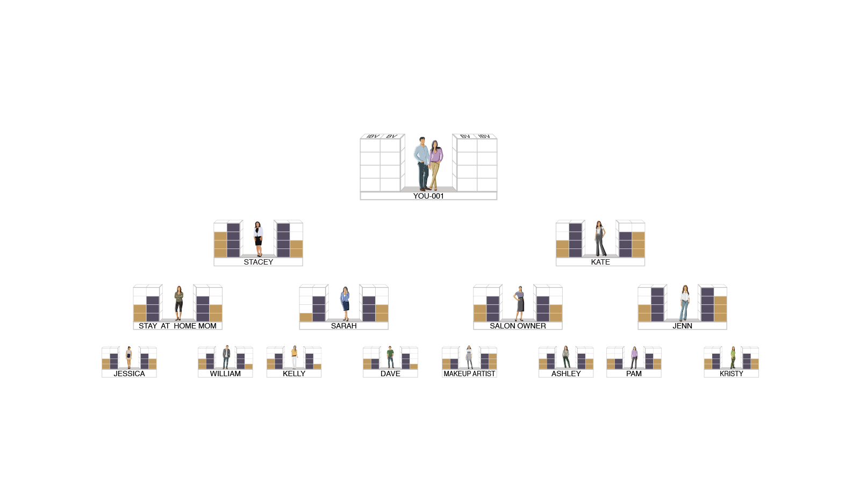
HOW COMMISSIONS ARE EARNED
BV AND IBV ARE TRACKED DAILY AND COMMISSIONS ARE CALCULATED WEEKLY
5000 / 5000 = $600
3600 / 3600 = $300
2400 / 2400 = $300
1200 / 1200 = $300
$1,500
5000 / 5000 = $600
3600 / 3600 = $300
2400 / 2400 = $300
1200 / 1200 = $300
$1,500
BV
5000
5000
IBV
3600
3600
2400
2400
1200
1200
TOTAL WEEKLY POTENTIAL $3,000 PER BDC
(PRO PARTNERS ARE ELIGIBLE FOR $600 BONUSES)

Slide 40
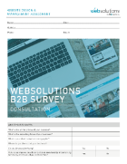
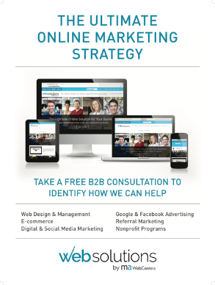
WHAT’S IN A PRO SUBSCRIPTION KIT?
PRO WEBCENTER
CUSTOMIZABLE WEBSITE MA WEBSITES
2 MONTHS UFMS *Pro Partners receive MA Subscription Kit as well
1-BUNDLE OF ASSESSMENT PADS
5-B2B SERVICES CATALOGS
5-RESOURCE MAGNETS
5-POSTERS
5-DECALS
*Additional Sales & Marketing tools available for purchase and Download.

Slide 41
WEBCENTER PRO OPTIONS
 | SALES REP (6073) OR NEW WC PRO AFFILIATE (1586) | SALES REP (1585) OR NEW WC PRO PARTNER (1574) | AFFILIATE UPGRADE TO PRO PARTNER (6080) | UFO UPGRADE TO PRO PARTNER (6072)
Pro WebCenter
Sales & Marketing Kit and MA Websites
UFMS
Market America Subscription Kit
Cost Associated BV | $259.95 100BV | $449.95 300BV | $219.95 100BV | $379 300BV
*All WebCenter Pro Accounts Monthly Fee: $79/ month and UFMS: $21.95/month

Slide 42
YOUR NEXT STEPS
CONTINUE YOUR RESEARCH Review www.mawc411.com Review www.mawebcenters.com
BOOK A FOLLOW-UP Schedule an appointment to get your questions answered and learn about the UnFranchise
ESTABLISH YOUR WEBCENTER PRO ACCOUNT Become a WebCenter Pro Affiliate or Pro Partner
Notes:
TRAINER’S NOTES:
Self explanatory

Slide 43
THANK YOU
WE LOOK FORWARD TO A SUCCESSFUL PARTNERSHIP

